Slide 1

Path Planning
Sim Justin
EE3305 Project 2 Presentation

Slide 2
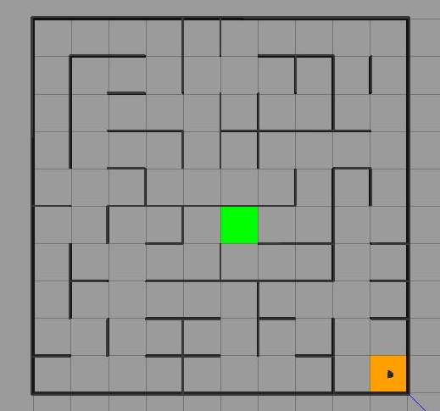
The maze

Slide 3
Changes made
Locomotion: Heading Correction Priority
Reduced Linear Velocity when Turning → Sharper Turns
Reduce U-Turn Overshooting
Path Planning: Diagonal Path Generation
Diagonal Path → Increased Efficiency

Slide 4
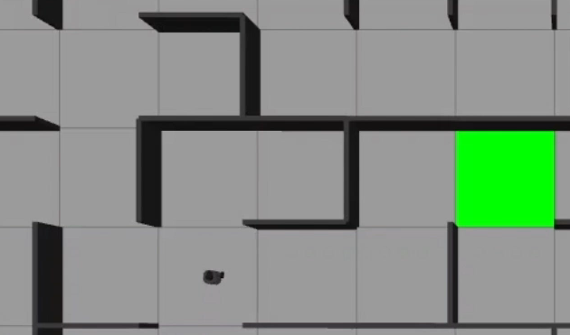
Heading correction priority
If (Error Angle > Setpoint): Decrease Linear Velocity

Slide 5
Diagonal path generation
Check both walls of diagonal taken, check corresponding walls of target cell
If 4 walls absent, go diagonally

Slide 6
No room for diagonal paths!

Slide 7
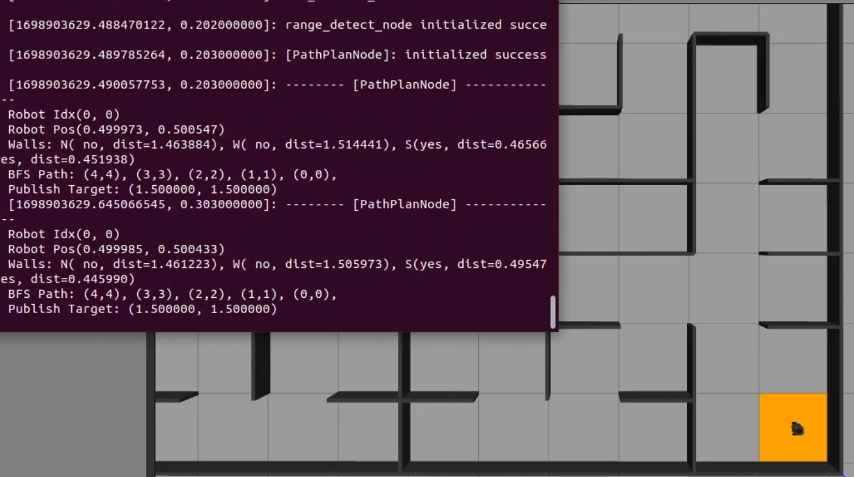
Diagonal path generation
Check both walls of diagonal taken, check corresponding walls of target cell
If 4 walls absent, go diagonally

Slide 8
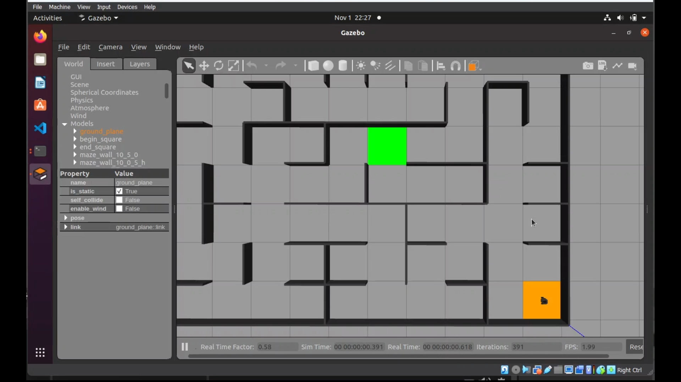
Full Video

